Slide 1
Statistics of RNA-seq analysis
Authors/Contributors:
Dominique Laurent Couturier, CRUK-CI
Zeynep Kalender-Atak, CRUK-CI
Hugo Tavares, Bioinformatics Training Facility, University of Cambridge
Notes:
In this session we’re going to cover some of the main statistical concepts that are relevant to differential expression analysis in RNA-seq data. We will also talk a little bit about experimental design and how it can impact the analysis of these data.
This is not a deep statistics lecture, but rather a brief overview of the key concepts.

Slide 2
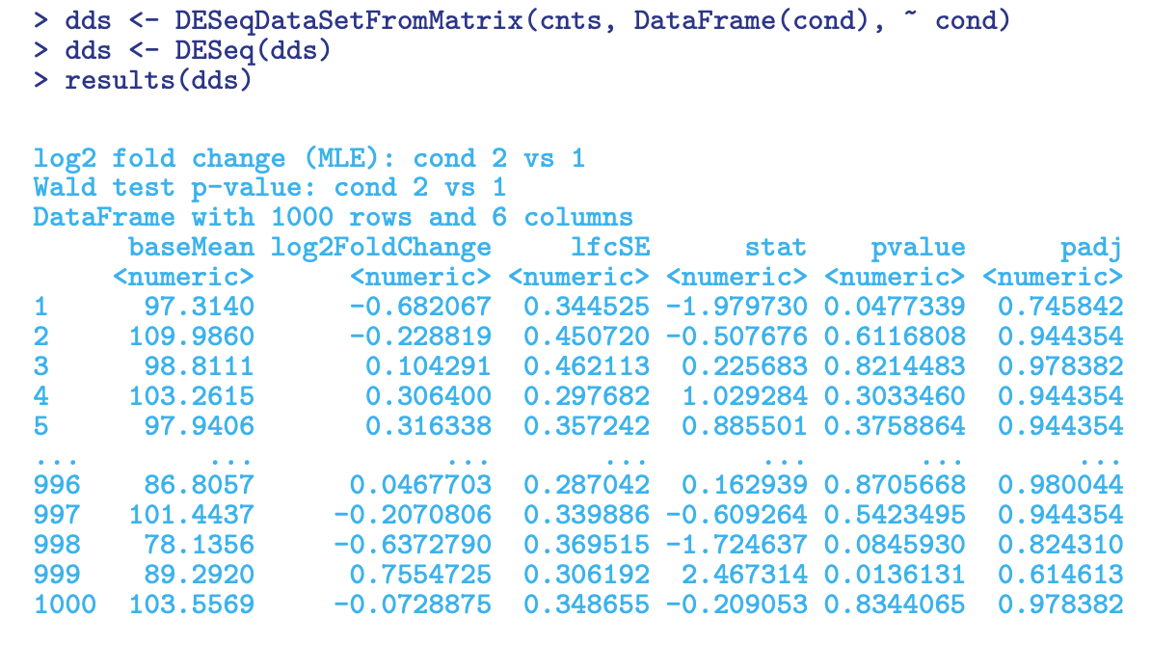
Notes:
In particular, our primary objective is to understand the meaning of the main output we will get from our differential expression analysis with DESeq2, which is a results table illustrated here (we will cover this in detail in a practical later in the course).

Slide 3


Image credit: The Pennsylvania State University

Slide 4
Data literacy
The ability to not only carry out statistical analysis on real-world problems, but also to understand and critique any conclusions drawn by others on the basis of statistics.

Slide 5
Statistics as an investigative process of problem-solving and decision-making
Understanding and defining the problem.
How do we go about answering this question?
What to measure and how?
Study design ?
Interpretation
Conclusions
New ideas
Communication
PROBLEM
PPDAC Cycle
CONCLUSION
PLAN
ANALYSIS
DATA
Sort data
Construct table, graphs
Look for patterns
Hypothesis generation
Collection
Management
Cleaning
R. J. MacKay. R. W. Oldford. "Scientific Method, Statistical Method and the Speed of Light." Statist. Sci. 15 (3) 254 - 278, August 2000.

Slide 6
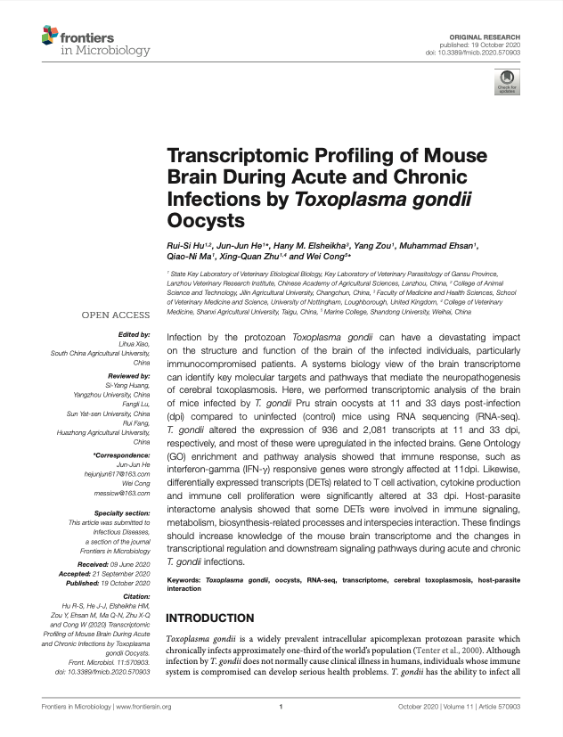
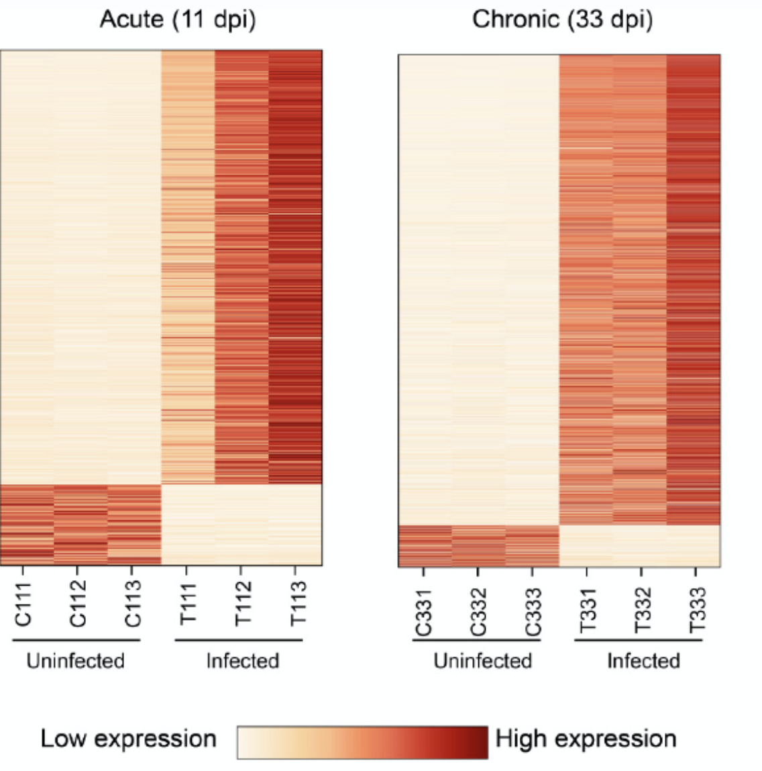
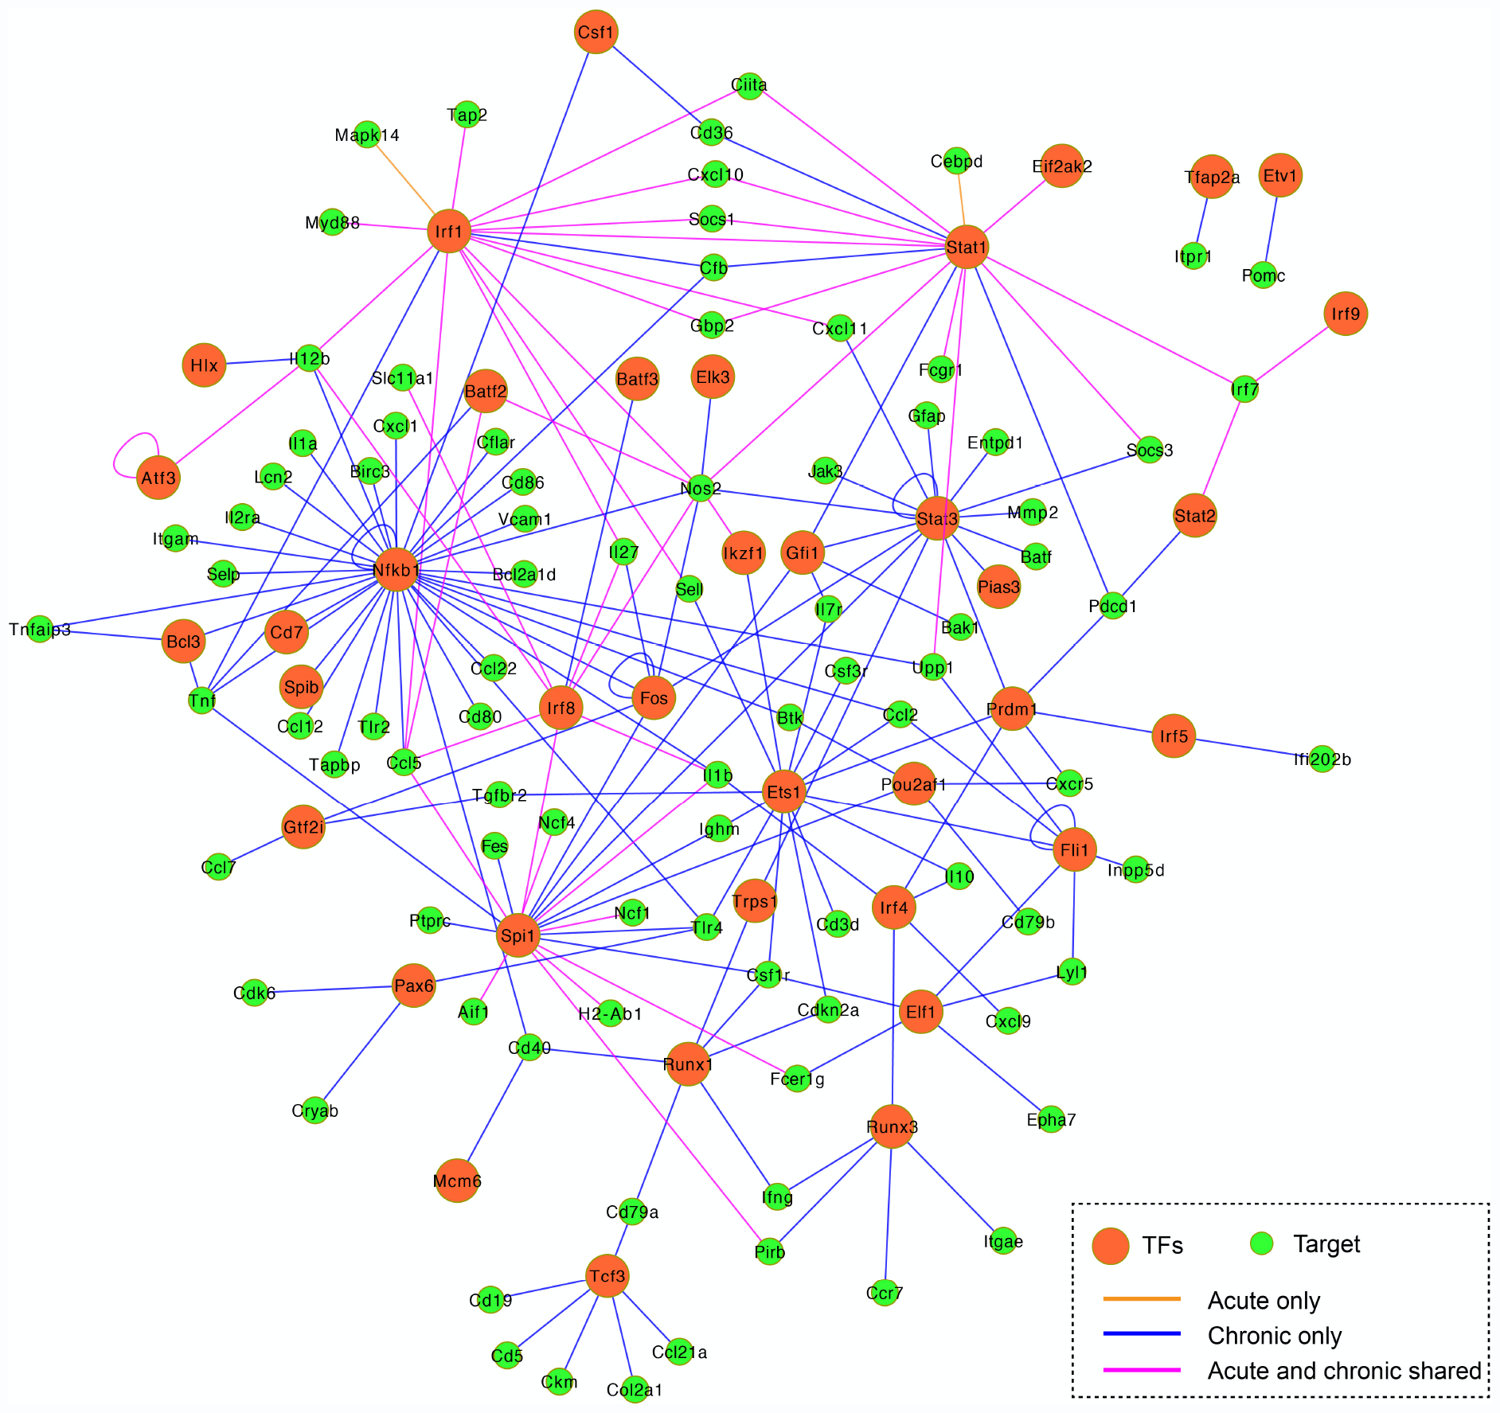
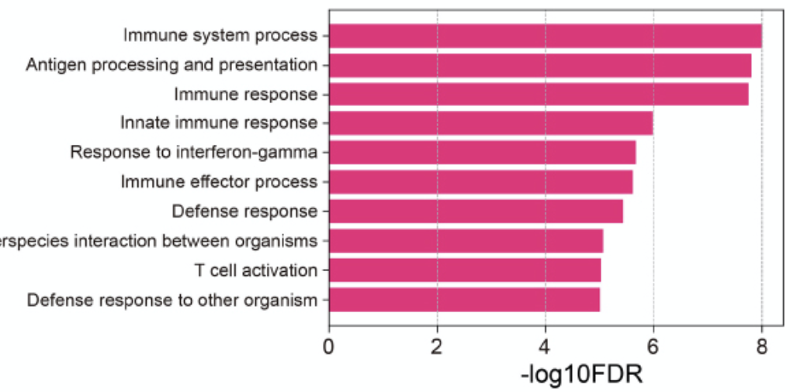
Statistics as an investigative process of problem-solving and decision-making
Understanding and defining the problem.
How do we go about answering this question?
Toxoplasma gondii infection causes a host of severe neurological disorders. Our understanding of the molecular mechanisms associated with infection is incomplete.
IFN-γ response increases as infection progresses
Calcium response pathways are downregulated
We want to study the effect of Toxoplasma gondii infection (chronic and acute) in mouse brain
What to measure and how?
Study design ?
Interpretation
Conclusions
New ideas
Communication
PROBLEM
PPDAC Cycle
Total gene expression profile of the brain in infection versus no-infection
A two-factor study with three biological replicates in each group with matched controls
CONCLUSION
PLAN
ANALYSIS
DATA
Sort data
Construct table, graphs
Look for patterns
Hypothesis generation
Collection
Management
Cleaning
Profiling the total transcriptome with RNA-seq
Preprocessing and quality control
Hu et al. Profiling of Mouse Brain During Acute and Chronic Infections by Toxoplasma gondii Oocysts. Front. Microbiol. 2020

Slide 7
Outline
Experimental Design
General Statistical Concepts
Statistical aspects specific to bulk RNA-seq analysis

Slide 8
Outline
Experimental Design
Statistical Concepts - Bite size statistics
Statistical aspects of bulk RNA-seq analysis

Slide 9
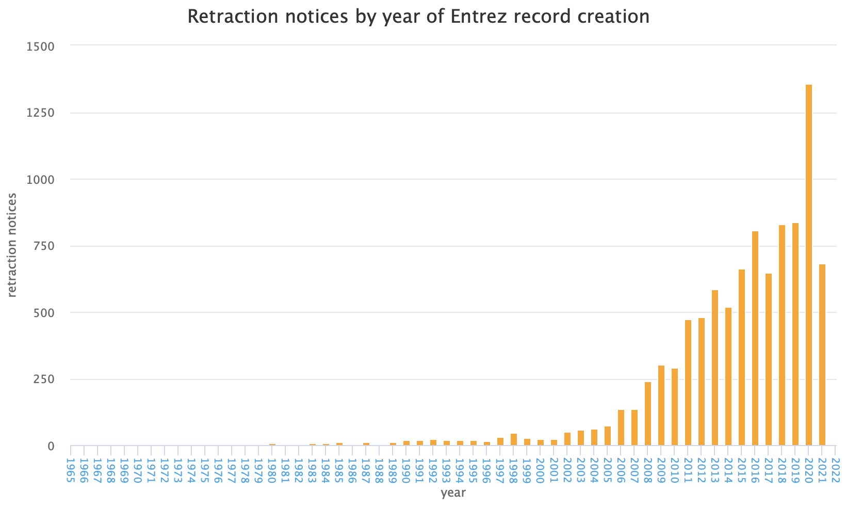
Crisis in Reproducible Research
http://neilfws.github.io/PubMed/pmretract/pmretract.html

Slide 10
Consequences of Poor Experimental Design
Inability to answer the questions we would like to answer
Cost of experimentation.
Limited & Precious material, esp. clinical samples.
Immortalization of data sets in public databases and methods in the literature. Our bad science begets more bad science.
Ethical concerns of experimentation: animals and clinical samples.

Slide 11
A Well-Designed Experiment
Should have
Clear objectives
Focus and simplicity
Sufficient power
Randomised comparisons
And be
Precise
Unbiased
Amenable to statistical analysis
Reproducible

Slide 12
Experimental Factors
Factors: aspects of experiment that change and influence the outcome of the experiment
e.g. time, weight, drug, gender, ethnicity, country, plate, cage etc.
Variable type depends on type of measurement:
Categorical (nominal) , e.g. gender
Categorical with ordering (ordinal), e.g. tumour grade
Discrete, e.g. shoe size, number of cells
Continuous, e.g. body weight in kg, height in cm
Independent and Dependent variables
Independent variable (IV): what you change
Dependent variable (DV): what changes due to IV
“If (independent variable), then (dependent variable)”

Slide 13
Sources of Variation
dependent variable = f ( independent variable ) + noise
Biological
Technical
Biological “noise”
Biological processes are inherently stochastic
Single cells, cell populations, individuals, organs, species….
Timepoints, cell cycle, synchronized vs. unsynchronized
Technical noise
Reagents, antibodies, temperatures, pollution
Platforms, runs, operators
Replication is required to capture variance

Slide 14
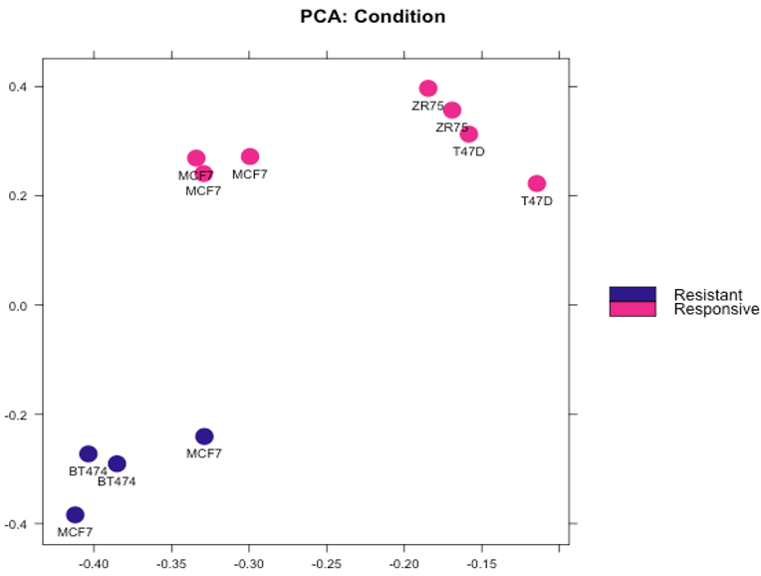
Types of Replication
Biological replication:
In vivo:
Patients
Mice
In vitro:
Different cell lines
Re-growing cells (passages)
Technical replication:
Experimental protocol
Measurement platform (i.e. sequencer)

Slide 15
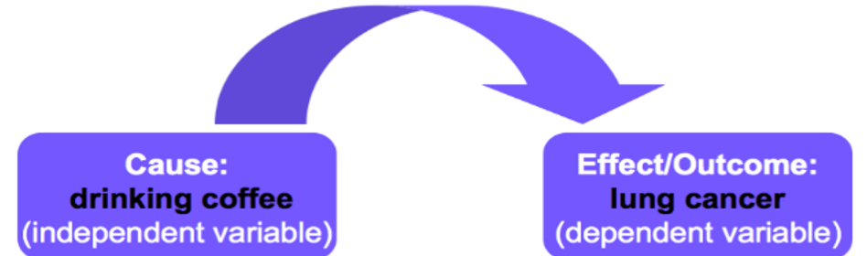
Confounding Factors
Also known as extraneous, hidden, lurking or masking factors, or the third variable or mediator variable.
May mask an actual association or falsely demonstrate an apparent association between the independent & dependent variables.
Hypothetical Example would be a study of coffee drinking and lung cancer.

Slide 16

Confounding Factors
Also known as extraneous, hidden, lurking or masking factors, or the third variable or mediator variable.
May mask an actual association or falsely demonstrate an apparent association between the independent & dependent variables.
Hypothetical Example would be a study of coffee drinking and lung cancer.

Slide 17
Solutions
Write it all down!!!!!!!!
Controlling technical effects:
Randomisation
Statistical analyses assume randomised comparisons
May not see issues caused by non-randomised comparisons
Make every decision random not arbitrary
Caveat: over-randomization can increase error
Blinding
Especially important where subjective measurements are taken
Potentially multiple degrees of blinding (eg. double-blinding)

Slide 18
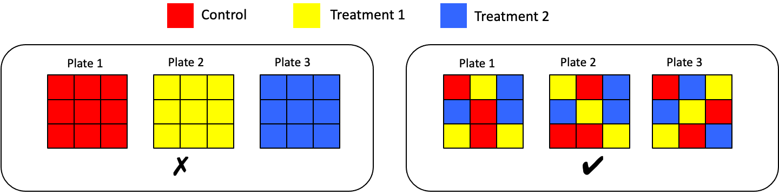
Randomised Block Design
Blocking is the arranging of experimental units in groups (blocks) that are similar to one another.
Each plate contains spatially randomised equal proportions of:
Control
Treatment 1
Treatment 2
controlling plate effects.

Slide 19
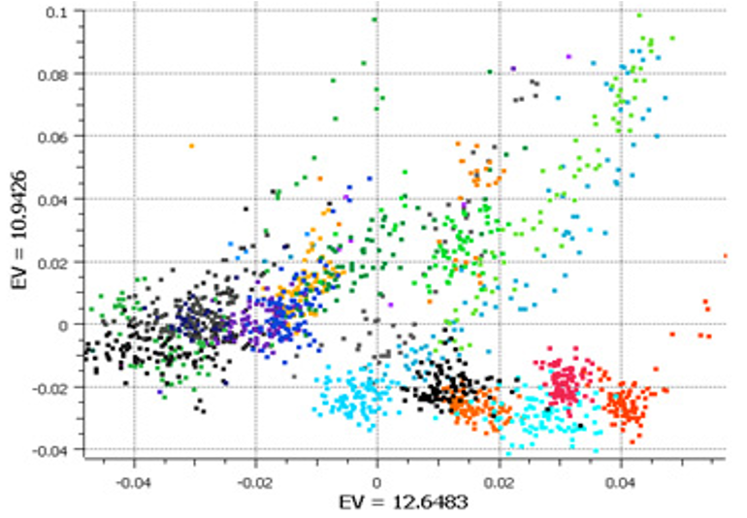
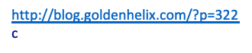
Randomised Block Design
Good design example: Alzheimer’s study from GlaxoSmithKline
Plate effects by plate
Left PCA plot show large plate effects.
Each colour corresponds to a different plate

Slide 20
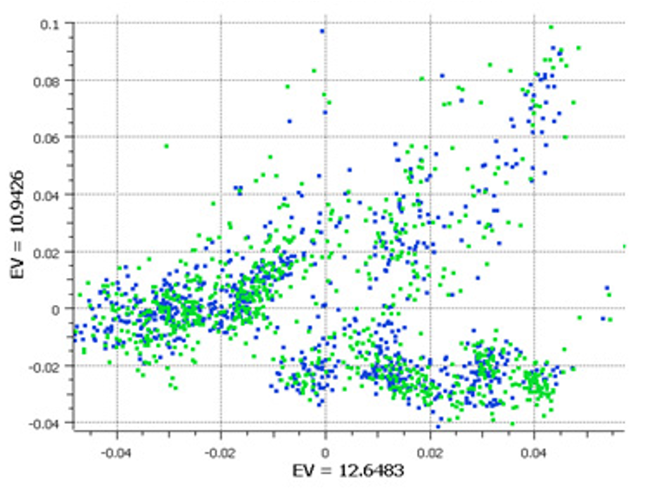
Randomised Block Design
Good design example: Alzheimer’s study from GlaxoSmithKline
Plate effects by plate
Left PCA plot show large plate effects.
Each colour corresponds to a different plate
Plate effects by case/control
Right PCA plot shows each plate cluster contains equal proportions of cases (blue) and controls (green).

Slide 21
Experimental Controls
Ideal : Everything is identical across conditions except the variable you are testing
Controlling errors
Type I: False Positives
Negative controls: should have minimal or no effect
Type II: False Negatives
Positive controls: known effect
Technical controls
Detect/correct technical biases
Normalise measurements (quantification)

Slide 22
Examples of Experimental Controls
Wild-type organism (knockouts)
Inactive siRNA (silencing)
Vehicle (treatments)
Spike-ins (quantification/normalisation)
“Gold standard” data points
Multi-level controls
e.g. contrast Vehicle/Input vs. Treatment/Input

Slide 23
Outline
Experimental Design
Statistical Concepts
Statistical aspects of bulk RNA-seq analysis

Slide 24

Basics on inferential statistics and hypothesis testing
Population: the complete set of individuals that we are interested in
Sample: smaller set of individuals that is representative of the population
Variable: what we are interested in measuring
Notes:
In this course, we are going to be using inferential statistics. What does that mean? With inferential statistics, you take data from samples and make generalizations about a population. Once you have a question that you want to pursue with a statistical enquiry, the first thing that you need to think about is the population. What is the population that I am considering in my experiment from which I will gather measurements? If you are working on breast cancer then your population of interest would be all breast cancer patients. Or if you are working with Drosophila Melanogaster, your population would be all drosophila melanogaster. Your sample will be then a smaller set of individuals that represent this population and that you can measure your variable of interest.
This is actually quite challenging - inferring something with only a handful of samples. And this is where statistical distributions are useful.

Slide 25

Basics on inferential statistics and hypothesis testing
Inference means two things:
Estimating population parameters
Testing hypothesis regarding the population distribution
Null Hypothesis (H₀)
Assumption about the population distribution and its parameters (mean, variance, etc)
inference
Population: the complete set of individuals that we are interested in
Sample: smaller set of individuals that is representative of the population
Variable: what we are interested in measuring
Slide content adapted from Matt Castle
Notes:
Inference means two things: estimating population parameters and testing hypothesis regarding the population distribution.

Slide 26
Basics on inferential statistics and hypothesis testing
Null Hypothesis (H₀)
Assumption about the population distribution and its parameters (mean, variance, etc)
Choose test
Based on data and H₀
Calculate test statistic, interpret results
Slide content adapted from Matt Castle
Notes:
Inference means two things: estimating population parameters and testing hypothesis regarding the population distribution.

Slide 27
A simple example
A neurologist is testing the effect of a drug on response time by injecting 100 rats with a unit dose of the drug subjecting each to neurological stimulus and recording its response time. The neurologist knows that the mean response time for rats not injected with the drug is 1.2 seconds. The mean of the 100 injected rats response times is 1.05 seconds with the sample standard deviation of 0.5 seconds. Do you think that the drug has an effect on response time ?
H₀: Drug has no effect on response time
H₁: Drug has an effect on response time
Example adapted from Sal Khan

Slide 28
A simple example
A neurologist is testing the effect of a drug on response time by injecting 100 rats with a unit dose of the drug subjecting each to neurological stimulus and recording its response time. The neurologist knows that the mean response time for rats not injected with the drug is 1.2 seconds. The mean of the 100 injected rats response times is 1.05 seconds with the sample standard deviation of 0.5 seconds. Do you think that the drug has an effect on response time ?
H₀: µ = 1.2 s
H₁: µ ≠ 1.2 s
Example adapted from Sal Khan
Notes:
We assume that the sampling distribution is normal - we have 100 observations, that's not an unreasonable assumption to make. If we assume the null hypothesis is true, the mean of the sampling distribution will be the same as the population mean, which is 1.2 seconds.

Slide 29
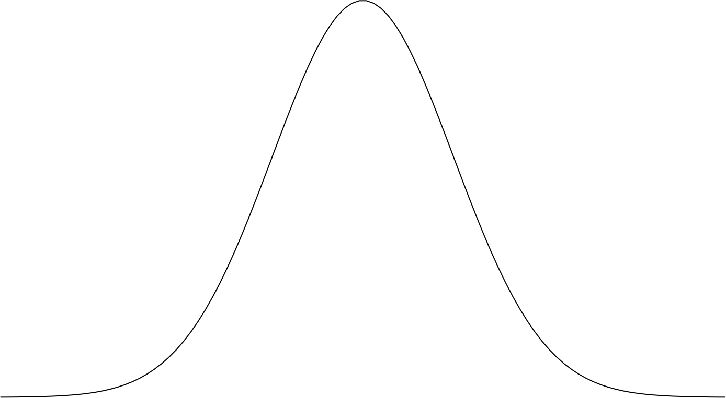
A simple example
A neurologist is testing the effect of a drug on response time by injecting 100 rats with a unit dose of the drug subjecting each to neurological stimulus and recording its response time. The neurologist knows that the mean response time for rats not injected with the drug is 1.2 seconds. The mean of the 100 injected rats response times is 1.05 seconds with the sample standard deviation of 0.5 seconds. Do you think that the drug has an effect on response time ?
H₀: µ = 1.2 s
H₁: µ ≠ 1.2 s
Assume H₀:
µ = 1.2 s
Example adapted from Sal Khan
Notes:
We assume that the sampling distribution is normal - we have 100 observations, that's not an unreasonable assumption to make. If we assume the null hypothesis is true, the mean of the sampling distribution will be the same as the population mean, which is 1.2 seconds.

Slide 30
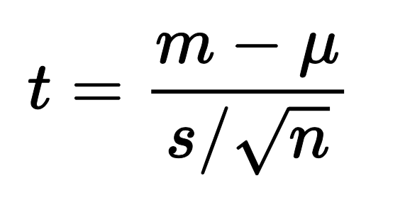
A simple example
A neurologist is testing the effect of a drug on response time by injecting 100 rats with a unit dose of the drug subjecting each to neurological stimulus and recording its response time. The neurologist knows that the mean response time for rats not injected with the drug is 1.2 seconds. The mean of the 100 injected rats response times is 1.05 seconds with the sample standard deviation of 0.5 seconds. Do you think that the drug has an effect on response time ?
H₀: µ = 1.2 s
H₁: µ ≠ 1.2 s
Calculate test statistic
Assume H₀:
µ = 1.2 s
Example adapted from Sal Khan
Notes:
We assume that the sampling distribution is normal - we have 100 observations, that's not an unreasonable assumption to make. If we assume the null hypothesis is true, the mean of the sampling distribution will be the same as the population mean, which is 1.2 seconds.

Slide 31




A simple example
A neurologist is testing the effect of a drug on response time by injecting 100 rats with a unit dose of the drug subjecting each to neurological stimulus and recording its response time. The neurologist knows that the mean response time for rats not injected with the drug is 1.2 seconds. The mean of the 100 injected rats response times is 1.05 seconds with the sample standard deviation of 0.5 seconds. Do you think that the drug has an effect on response time ?
H₀: µ = 1.2 s
H₁: µ ≠ 1.2 s
1.05
1.2
Calculate test statistic
0.5
100
Assume H₀:
µ = 1.2 s
Example adapted from Sal Khan
Notes:
We assume that the sampling distribution is normal - we have 100 observations, that's not an unreasonable assumption to make. If we assume the null hypothesis is true, the mean of the sampling distribution will be the same as the population mean, which is 1.2 seconds.

Slide 32
A simple example
A neurologist is testing the effect of a drug on response time by injecting 100 rats with a unit dose of the drug subjecting each to neurological stimulus and recording its response time. The neurologist knows that the mean response time for rats not injected with the drug is 1.2 seconds. The mean of the 100 injected rats response times is 1.05 seconds with the sample standard deviation of 0.5 seconds. Do you think that the drug has an effect on response time ?
H₀: µ = 1.2 s
H₁: µ ≠ 1.2 s
Calculate test statistic
= - 3
Assume H₀:
µ = 1.2 s
Example adapted from Sal Khan
Notes:
We assume that the sampling distribution is normal - we have 100 observations, that's not an unreasonable assumption to make. If we assume the null hypothesis is true, the mean of the sampling distribution will be the same as the population mean, which is 1.2 seconds.

Slide 33
A simple example
A neurologist is testing the effect of a drug on response time by injecting 100 rats with a unit dose of the drug subjecting each to neurological stimulus and recording its response time. The neurologist knows that the mean response time for rats not injected with the drug is 1.2 seconds. The mean of the 100 injected rats response times is 1.05 seconds with the sample standard deviation of 0.5 seconds. Do you think that the drug has an effect on response time ?
H₀: µ = 1.2 s
H₁: µ ≠ 1.2 s
Calculate test statistic
= - 3
Assume H₀:
This means that the sample mean (1.05) is 3 standard deviations away from the mean
-3𝝈
-2𝝈
-1𝝈
µ = 1.2 s
𝝈
2𝝈
3𝝈
Example adapted from Sal Khan

Slide 34
A simple example
A neurologist is testing the effect of a drug on response time by injecting 100 rats with a unit dose of the drug subjecting each to neurological stimulus and recording its response time. The neurologist knows that the mean response time for rats not injected with the drug is 1.2 seconds. The mean of the 100 injected rats response times is 1.05 seconds with the sample standard deviation of 0.5 seconds. Do you think that the drug has an effect on response time ?
H₀: µ = 1.2 s
H₁: µ ≠ 1.2 s
Calculate test statistic
= - 3
Assume H₀:
This means that the sample mean (1.05) is 3 standard deviations away from the mean
68 %
What is the probability of observing a test statistic as extreme as 1.05?
95 %
99.7 %
-3𝝈
-2𝝈
-1𝝈
µ = 1.2 s
𝝈
2𝝈
3𝝈
Example adapted from Sal Khan

Slide 35
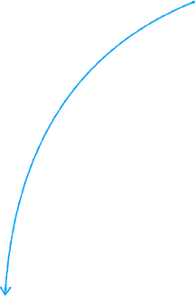

A simple example
A neurologist is testing the effect of a drug on response time by injecting 100 rats with a unit dose of the drug subjecting each to neurological stimulus and recording its response time. The neurologist knows that the mean response time for rats not injected with the drug is 1.2 seconds. The mean of the 100 injected rats response times is 1.05 seconds with the sample standard deviation of 0.5 seconds. Do you think that the drug has an effect on response time ?
H₀: µ = 1.2 s
H₁: µ ≠ 1.2 s
Calculate test statistic
= - 3
0.003
Assume H₀:
This means that the sample mean (1.05) is 3 standard deviations away from the mean
68 %
What is the probability of observing a test statistic as extreme as 1.05?
95 %
99.7 %
-3𝝈
-2𝝈
-1𝝈
µ = 1.2 s
𝝈
2𝝈
3𝝈
Example adapted from Sal Khan
Notes:
If the null hypothesis is true, then there is 1 in 300 chance to observe a mean response time of 1.05.

Slide 36
A simple example
A neurologist is testing the effect of a drug on response time by injecting 100 rats with a unit dose of the drug subjecting each to neurological stimulus and recording its response time. The neurologist knows that the mean response time for rats not injected with the drug is 1.2 seconds. The mean of the 100 injected rats response times is 1.05 seconds with the sample standard deviation of 0.5 seconds. Do you think that the drug has an effect on response time ?
H₀: µ = 1.2 s
H₁: µ ≠ 1.2 s
Calculate test statistic
= - 3
p-value
0.003
Assume H₀:
This means that the sample mean (1.05) is 3 standard deviations away from the mean
68 %
What is the probability of observing a test statistic as extreme as 1.05?
95 %
99.7 %
p-value = 2 min[P(t ≤ t_{obs}|H₀),P(t ≥ t_{obs}|H₀)]
-3𝝈
-2𝝈
-1𝝈
µ = 1.2 s
𝝈
2𝝈
3𝝈
Example adapted from Sal Khan
Notes:
If the null hypothesis is true, then there is 1 in 300 chance to observe a mean response time of 1.05.

Slide 37
A simple example
A neurologist is testing the effect of a drug on response time by injecting 100 rats with a unit dose of the drug subjecting each to neurological stimulus and recording its response time. The neurologist knows that the mean response time for rats not injected with the drug is 1.2 seconds. The mean of the 100 injected rats response times is 1.05 seconds with the sample standard deviation of 0.5 seconds. Do you think that the drug has an effect on response time ?
H₀: µ = 1.2 s
H₁: µ ≠ 1.2 s
Calculate test statistic
= - 3
p-value
0.003
Assume H₀:
This means that the sample mean (1.05) is 3 standard deviations away from the mean
68 %
What is the probability of observing a test statistic as extreme as 1.05?
95 %
99.7 %
p-value = 2 min[P(t ≤ t_{obs}|H₀),P(t ≥ t_{obs}|H₀)]
-3𝝈
-2𝝈
-1𝝈
µ = 1.2 s
𝝈
2𝝈
3𝝈
We reject the null hypothesis!
Example adapted from Sal Khan
Notes:
If the null hypothesis is true, then there is 1 in 300 chance to observe a mean response time of 1.05.

Slide 38

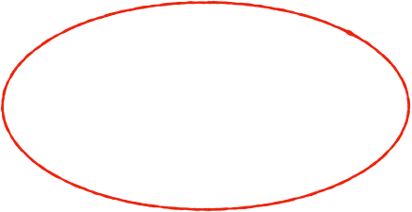

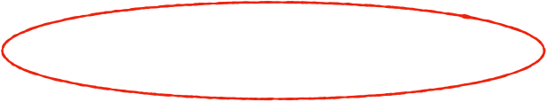
A simple example
Constructed the null and alternative hypothesis about the population
A neurologist is testing the effect of a drug on response time by injecting 100 rats with a unit dose of the drug subjecting each to neurological stimulus and recording its response time. The neurologist knows that the mean response time for rats not injected with the drug is 1.2 seconds. The mean of the 100 injected rats response times is 1.05 seconds with the sample standard deviation of 0.5 seconds. Do you think that the drug has an effect on response time ?
H₀: µ = 1.2 s
H₁: µ ≠ 1.2 s
Calculate test statistic
= - 3
Obtained p-value
Calculated test statistic
p-value
0.003
Assume H₀:
This means that the sample mean (1.05) is 3 standard deviations away from the mean
68 %
What is the probability of observing a test statistic as extreme as 1.05?
95 %
99.7 %
p-value = 2 min[P(t ≤ t_{obs}|H₀),P(t ≥ t_{obs}|H₀)]
Reached a conclusion
-3𝝈
-2𝝈
-1𝝈
µ = 1.2 s
𝝈
2𝝈
3𝝈
We reject the null hypothesis!
Example adapted from Sal Khan
Notes:
If the null hypothesis is true, then there is 1 in 300 chance to observe a mean response time of 1.05.

Slide 39
Key Concepts - Hypothesis Testing
All statistical tests are based on assumptions!
All statistics can be wrong
Statistical tests are probabilistic in nature
There is always a chance that the result is wrong (even when all assumptions met perfectly):
Either significant result when no difference (Type I),
Or insignificant results when there is an actual difference (Type II)
Slide content adapted from Matt Castle

Slide 40

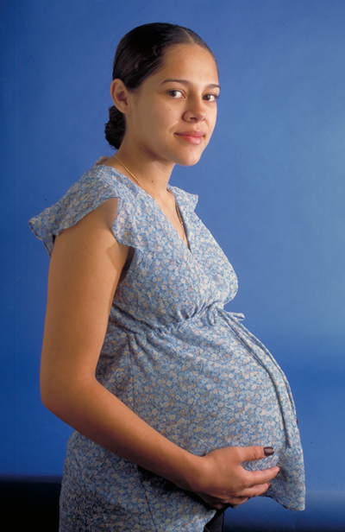
Type I and Type II Errors
All hypothesis tests involve making a decision:
Is this result significant or not?
This decision can be wrong in two ways:
Type I error or False positive
Type II error or False negative
This is when you reject the null hypothesis when it is true
This is when you fail to reject the null hypothesis when it isn't true
"You're pregnant !"
"You're not pregnant"
Slide content adapted from Matt Castle

Slide 41
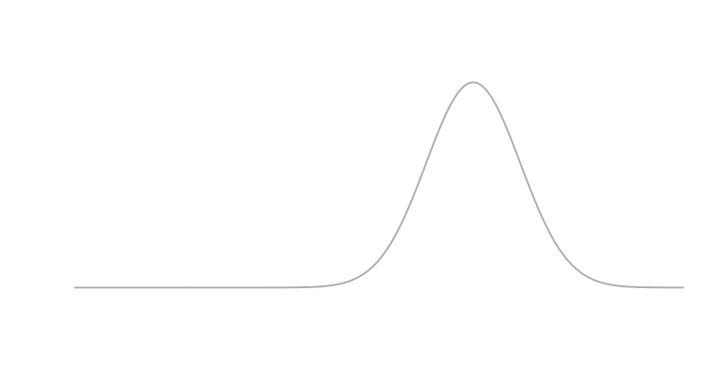
Type I and Type II Errors
H₀: µ = 1.2 s
H₁: µ ≠ 1.2 s
if p-value > ⍺ → do not reject H₀
if p-value < ⍺ → reject H₀ in favour of H₁
⍺=0.05 → the type I error, the probability of rejecting
H₀ when H₀ is correct
µ = 1.2 s
Notes:
Type I error is easy - when you decide to do a statistical test, you need to decide beforehand what your significance threshold would be. At what error rate you will reject the null hypothesis - 0.05 is a common choice depending on the field. This value is actually your probability of rejecting the null hypothesis even if it's true. In this plot, your significance levels is the red shaded area, and you took a sample and its mean falls into this shaded area, then you reject the null hypothesis. And if your null hypothesis is actually true, you would be committing a Type I error without knowing about it. If we go back to the example we have discussed, this was the probability distribution with mean of 1.2 seconds.

Slide 42
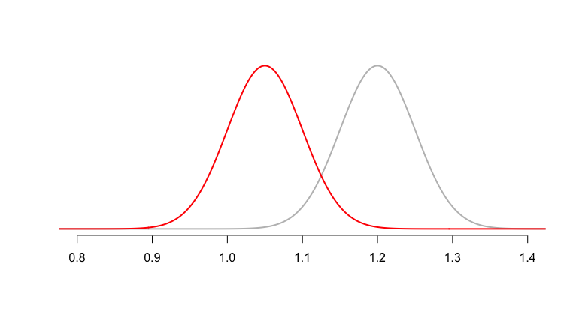
Type I and Type II Errors
H₀: µ = 1.2 s
H₁: µ ≠ 1.2 s
Suppose H₁ true:
if p-value > ⍺ → do not reject H₀
if p-value < ⍺ → reject H₀ in favour of H₁
Depending on your sampling, you might fail to reject H₀
⍺=0.05 → the type I error, the probability of rejecting
H₀ when H₀ is correct
µ = 1.2 s
Notes:
Type I error is easy - when you decide to do a statistical test, you need to decide before hand what your significance threshold would be. At what error rate you will reject the null hypothesis - 0.05 is a common choice depending on the field. This value is actually your probability of rejecting the null hypothesis even if it's true. In this plot, your significance levels is the red shaded area, and you took a sample and its mean falls into this shaded area, then you reject the null hypothesis. And if your null hypothesis is actually true, you would be committing a Type I error without knowing about it. If we go back to the example we have discussed, this was the probability distribution with mean of 1.2 seconds.

Slide 43

Type I and Type II Errors
H₀: µ = 1.2 s
H₁: µ ≠ 1.2 s
Suppose H₁ true:
if p-value > ⍺ → do not reject H₀
if p-value < ⍺ → reject H₀ in favour of H₁
⍬ → the type II error, the probability of not rejecting
H₀ when H₁ is correct
⍺=0.05 → the type I error, the probability of rejecting
H₀ when H₀ is correct
µ = 1.2 s
µ = 1.05 s
µ = 1.2 s
Notes:
Type I error is easy - when you decide to do a statistical test, you need to decide before hand what your significance threshold would be. At what error rate you will reject the null hypothesis - 0.05 is a common choice depending on the field. This value is actually your probability of rejecting the null hypothesis even if it's true. In this plot, your significance levels is the red shaded area, and you took a sample and its mean falls into this shaded area, then you reject the null hypothesis. And if your null hypothesis is actually true, you would be committing a Type I error without knowing about it. If we go back to the example we have discussed, this was the probability distribution with mean of 1.2 seconds.

Slide 44

Type I and Type II Errors
H₀: µ = 1.2 s
H₁: µ ≠ 1.2 s
Suppose H₁ true:
if p-value > ⍺ → do not reject H₀
if p-value < ⍺ → reject H₀ in favour of H₁
θ → the type II error, the probability of not rejecting
H₀ when H₁ is correct
1- θ → Power is the probability that we actually detect
an effect that exists
⍺=0.05 → the type I error, the probability of rejecting
H₀ when H₀ is correct
µ = 1.2 s
µ = 1.05 s
µ = 1.2 s
Notes:
Power is directly associated with Type I error, if you nudge this line to the left, in other words, if you increase your Type I error, you increase your power. Another way to boost power is to increase sample sizes, if you have larger sample sizes these sampling distributions would be steeper, the variance would be lower. There are

Slide 45
Power Analysis
Effect Size (δ)
Sample Size (n)
The four concepts are linked
If we know three, we can work out the forth
Power calculation: Aim is to define the probability (1-θ) to detect an effect size of interest (δ) at the ⍺ level with a sample size of n biological replicates
Sample size calculation: Aim is to define the sample size (n) allowing to detect an effect size of interest (δ) at the α level with a given probability (1 − θ).
Significance Level (⍺)
Power (1 − θ)

Slide 46
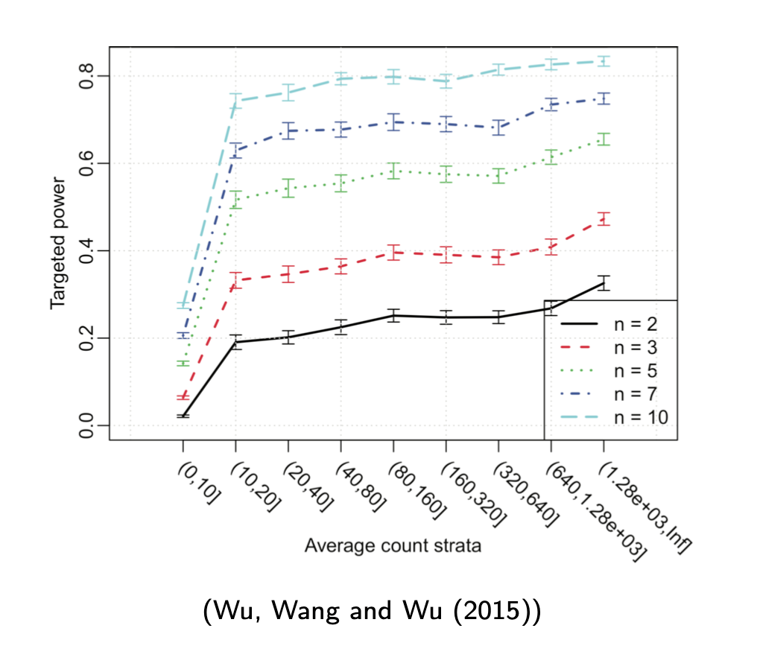
Power Analysis in Differential Expression Analysis

Slide 47
Outline
Experimental Design
Statistical Concepts - Bite size statistics
Statistical aspects of bulk RNA-seq analysis

Slide 48
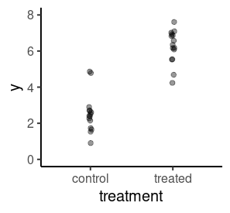
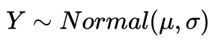
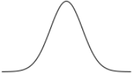
Statistical Aspects of Differential Expression Analysis
Linear Modeling
Model the expression of each gene as linear combination of explanatory factors (eg. treatment, age, sex, etc.)
y - expression of the gene
𝞫_{i} - parameters we want to estimate from the data
𝞫₀ - the “intercept” (the value of expression when all other parameters are set at a reference level)
σ - the standard deviation (uncertainty) of our model (also estimated from the data)
Notes:
We could use a model just as the one we talked about earlier, assuming a normal distribution as the data generating process to model our data.

Slide 49
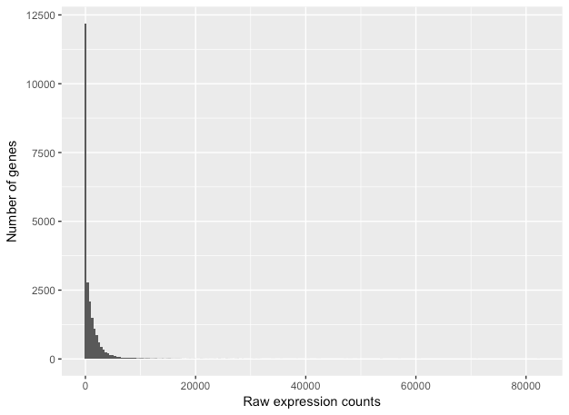
Statistical Aspects of Differential Expression Analysis
Characteristics of RNA-seq data
This plot illustrates some common features of RNA-seq count data:
a low number of counts associated with a large proportion of genes
a long right tail due to the lack of any upper limit for expression
large dynamic range
Looking at the shape of the histogram, we see that it is not normally distributed.

Slide 50
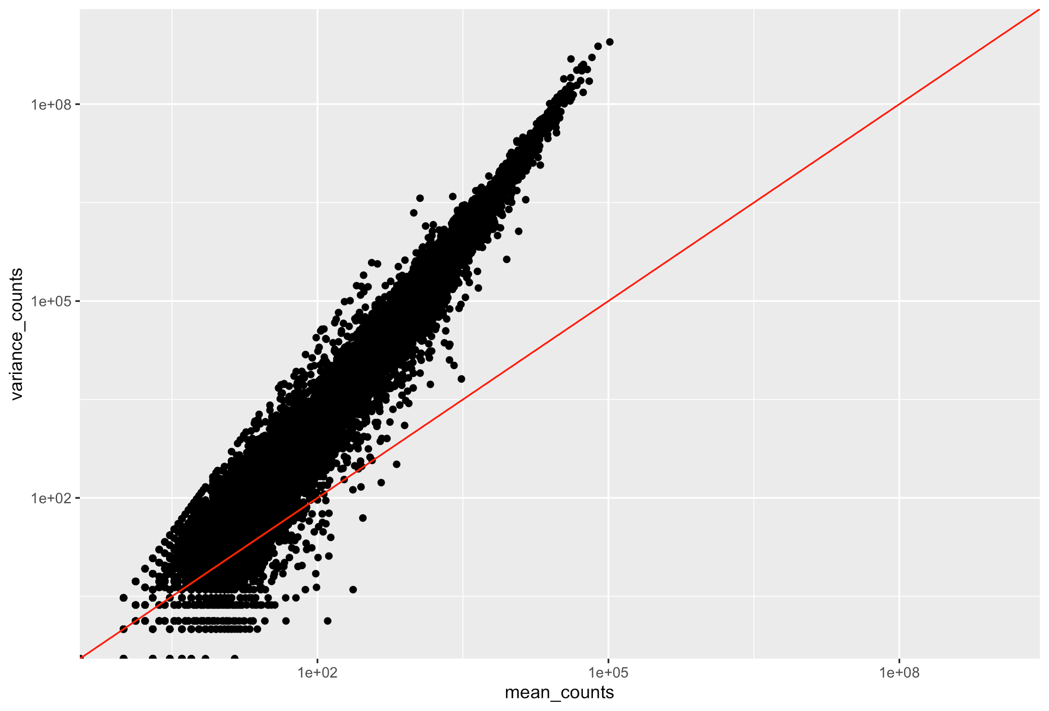
Statistical Aspects of Differential Expression Analysis
Characteristics of RNA-seq data
To assess the properties of the data we are working with, we can look at the mean-variance relationship.
For the genes with high mean expression, the variance across replicates tends to be greater than the mean (scatter is above the red line).
Essentially, the Negative Binomial is a good approximation for data where the mean < variance, as is the case with RNA-Seq count data.

Slide 51
Statistical Aspects of Differential Expression Analysis
Linear Modeling
Model the expression of each gene as linear combination of explanatory factors (eg. treatment, age, sex, etc.)
y - expression of the gene
𝞫_{i} - parameters we want to estimate from the data
𝞫₀ - the “intercept” (the value of expression when all other parameters are set at a reference level)
σ - the standard deviation (uncertainty) of our model (also estimated from the data)
Notes:
We could use a model just as the one we talked about earlier, assuming a normal distribution as the data generating process to model our data.

Slide 52
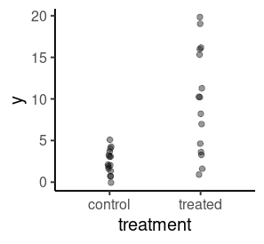
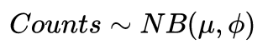
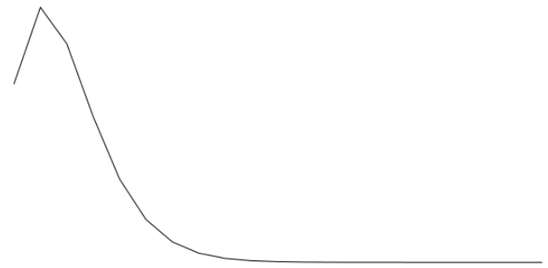
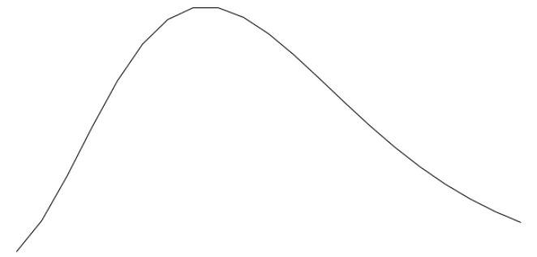
Statistical Aspects of Differential Expression Analysis
Linear Modeling
Model the expression of each gene as linear combination of explanatory factors (eg. treatment, age, sex, etc.)
Counts - expression of the gene
𝞫_{i} - parameters we want to estimate from the data
𝞫₀ - the “intercept” (the value of expression when all other parameters are set at a reference level)
ɸ - the “dispersion” (uncertainty) of our model (also estimated from the data)
Notes:
Here we have mean = 2 and mean = 10 with same dispersion for both (5)

Slide 53
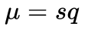
Statistical Aspects of Differential Expression Analysis
Linear Modeling
Model the expression of each gene as linear combination of explanatory factors (eg. treatment, age, sex, etc.)
counts - expression of the gene
𝞫_{i} - parameters we want to estimate from the data
𝞫₀ - the “intercept” (the value of expression when all other parameters are set at a reference level)
ɸ - the “dispersion” (uncertainty) of our model (also estimated from the data)
s - scaling factor (sequencing depth and transcript composition)
Notes:
Here we have mean = 2 and mean = 10 with same dispersion for both (5)

Slide 54
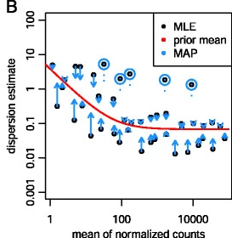
Statistical Aspects of Differential Expression Analysis
Linear Modeling
Model the expression of each gene as linear combination of explanatory factors (eg. treatment, age, sex, etc.)
counts - expression of the gene
𝞫_{i} - parameters we want to estimate from the data
𝞫₀ - the “intercept” (the value of expression when all other parameters are set at a reference level)
ɸ - the “dispersion” (uncertainty) of our model (also estimated from the data)
s - scaling factor (sequencing depth and transcript composition)

Slide 55
Statistical Aspects of Differential Expression Analysis
Linear Modeling
Model the expression of each gene as linear combination of explanatory factors (eg. treatment, age, sex, etc.)
Coefficients are estimated for each sample group along with their standard error.
The coefficients are the estimates for the log2 fold-changes, and will be used as input for hypothesis testing.
counts - expression of the gene
𝞫_{i} - parameters we want to estimate from the data
𝞫₀ - the “intercept” (the value of expression when all other parameters are set at a reference level)
ɸ - the “dispersion” (uncertainty) of our model (also estimated from the data)
s - scaling factor (sequencing depth and transcript composition)

Slide 56
Statistical Aspects of Differential Expression Analysis
Linear Modeling
Summary:
Use negative binomial linear regression to model gene expression in RNA-seq
Calculate size factors for each sample to account for differences in sequencing depth and transcript composition between samples
Estimate dispersion for each gene by “borrowing” information across genes for more precise estimates when sample sizes are small (as is typical in RNA-seq experiments)
Estimate model coefficients which are used to define test hypothesis (𝞫_{i} = 0)
counts - expression of the gene
𝞫_{i} - parameters we want to estimate from the data
𝞫₀ - the “intercept” (the value of expression when all other parameters are set at a reference level)
ɸ - the “dispersion” (uncertainty) of our model (also estimated from the data)
s - scaling factor (sequencing depth and transcript composition)
Description of DESeq2 model: Love, Huber & Anders (2014)

Slide 57
Statistical Aspects of Differential Expression Analysis
Linear Modeling
Model the expression of each gene as linear combination of explanatory factors (eg. treatment, age, sex, etc.)
y = a + (b * treatment) + (c * age) + (d * sex) + e
y = expression of gene
a, b, c, d = parameters estimated from the data
a = intercept (expression when factors are at reference level)
e = error term
observation = deterministic model + residual error

Slide 58
Statistical Aspects of Differential Expression Analysis
Linear Modeling
Collect the information related to each sample for predictors of interest
Define β, the sets of parameters we are interested in
build the X matrix that relates the sample information with the β
estimate the β and use statistical inference to assess significance (p-values)

Slide 59
Construction of Design Matrix
Next Session!

Slide 60
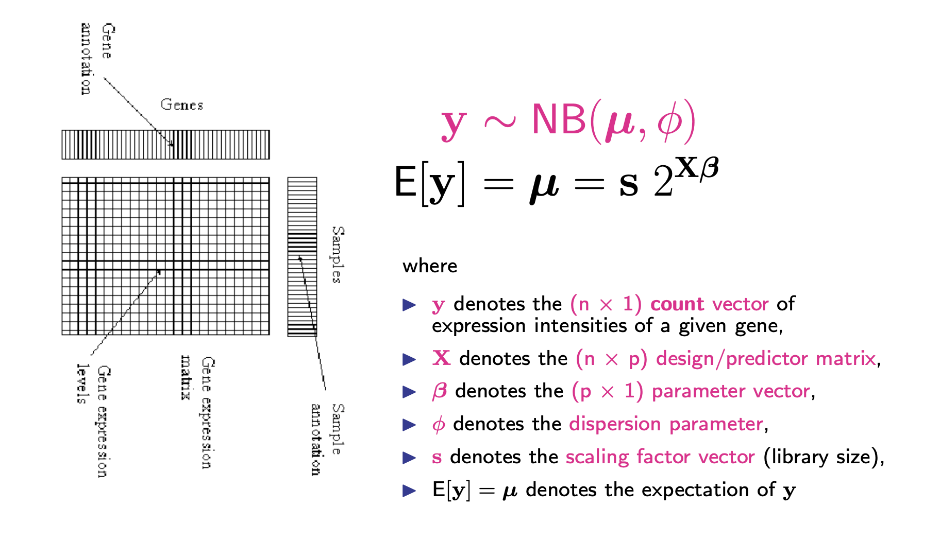
Statistical Aspects of Differential Expression Analysis
Negative Binomial Regression
After the model is fit, coefficients are estimated for each sample group along with their standard error. The coefficents are the estimates for the log2 fold-changes, and will be used as input for hypothesis testing.

Slide 61
Statistical Aspects of Differential Expression Analysis
Negative Binomial Regression
Recall the simple linear regression model for expression:
y = β₀+ β₁X + ε
where X=0 (untreated)
or X=1 (treated)
y is the observed ”expression” of the gene
ε is the measurement noise term
The parameter of interest is β1 (the treatment effect)

Slide 62
Statistical Aspects of Differential Expression Analysis
General Hypothesis
Is the RNA abundance level for any of the m genes affected by treatment
Let H_{0j} denote the null hypothesis for gene j
H_{0j}: The RNA abundance level for gene j is not affected by treatment
H_{1j}: The RNA abundance level for gene j is affected by treatment
The global null hypothesis is H₀₁ and H₀₂ and .. and .. H_{0m} are all true
The global alternative is H₁₁ or H₁₂ or .. or .. H_{1m} is true
In other words, under the alternative at least one of the alternative hypothesis is true

Slide 63
Statistical Aspects of Differential Expression Analysis
General Hypothesis
The global null hypothesis: β₁₁=0 and β₂₁=0 and βm₁=0
In other words, all of the β_{j1} are equal to zero
The global alternative is β₁₁ ≠ 0 or β₂₁ ≠ 0 or ... or β_{m1} ≠ 0
In other words, at least one of the β_{j1} is not equal to zero.

Slide 64
Multiplicity Correction
A gene with a significance cut-off of α = 0.05, means there is a 5% chance it is a false positive.
If we test for 20,000 genes for differential expression at α = 0.05, we would expect to find 1,000 genes by chance
If we found 3000 genes to be differentially expressed total, roughly one third of our genes are false positives!
The more genes we test, the more we inflate the false positive rate. This is the multiple testing problem.

Slide 65
Multiplicity Correction
Bonferroni: The adjusted p-value is calculated by: α * k (k = total number of tests). This is a very conservative approach
FDR/Benjamini-Hochberg: Benjamini and Hochberg (1995) defined the concept of FDR and created an algorithm to control the expected FDR below a specified level given a list of independent p-values.

Slide 66
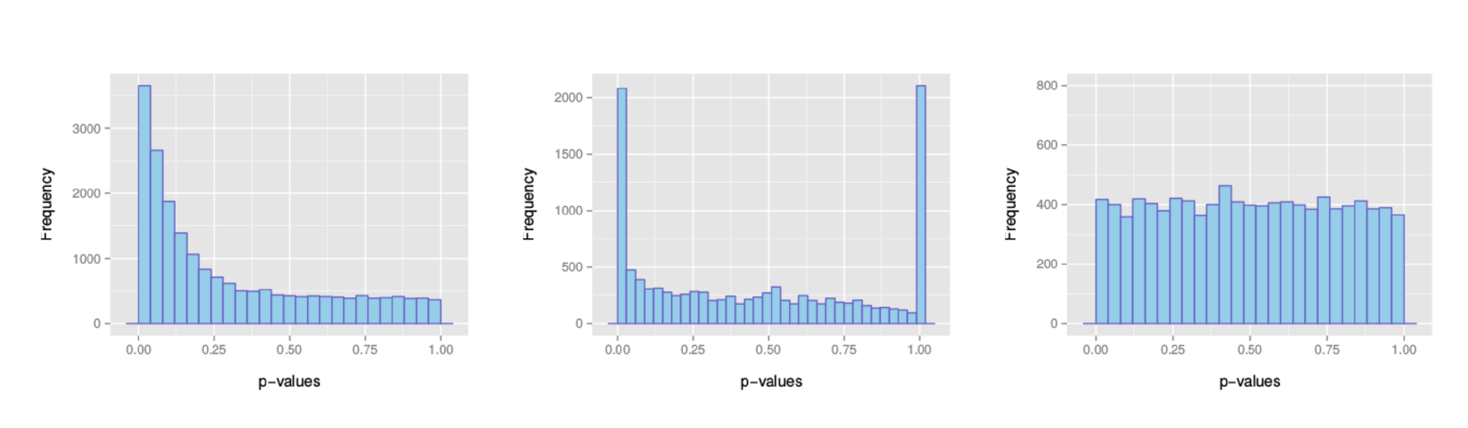
Multiplicity Correction
Examples of expected overall distribution
: the most desirable shape
: very low counts genes usually have large p-values
: do not expect positive tests after correction

Slide 67
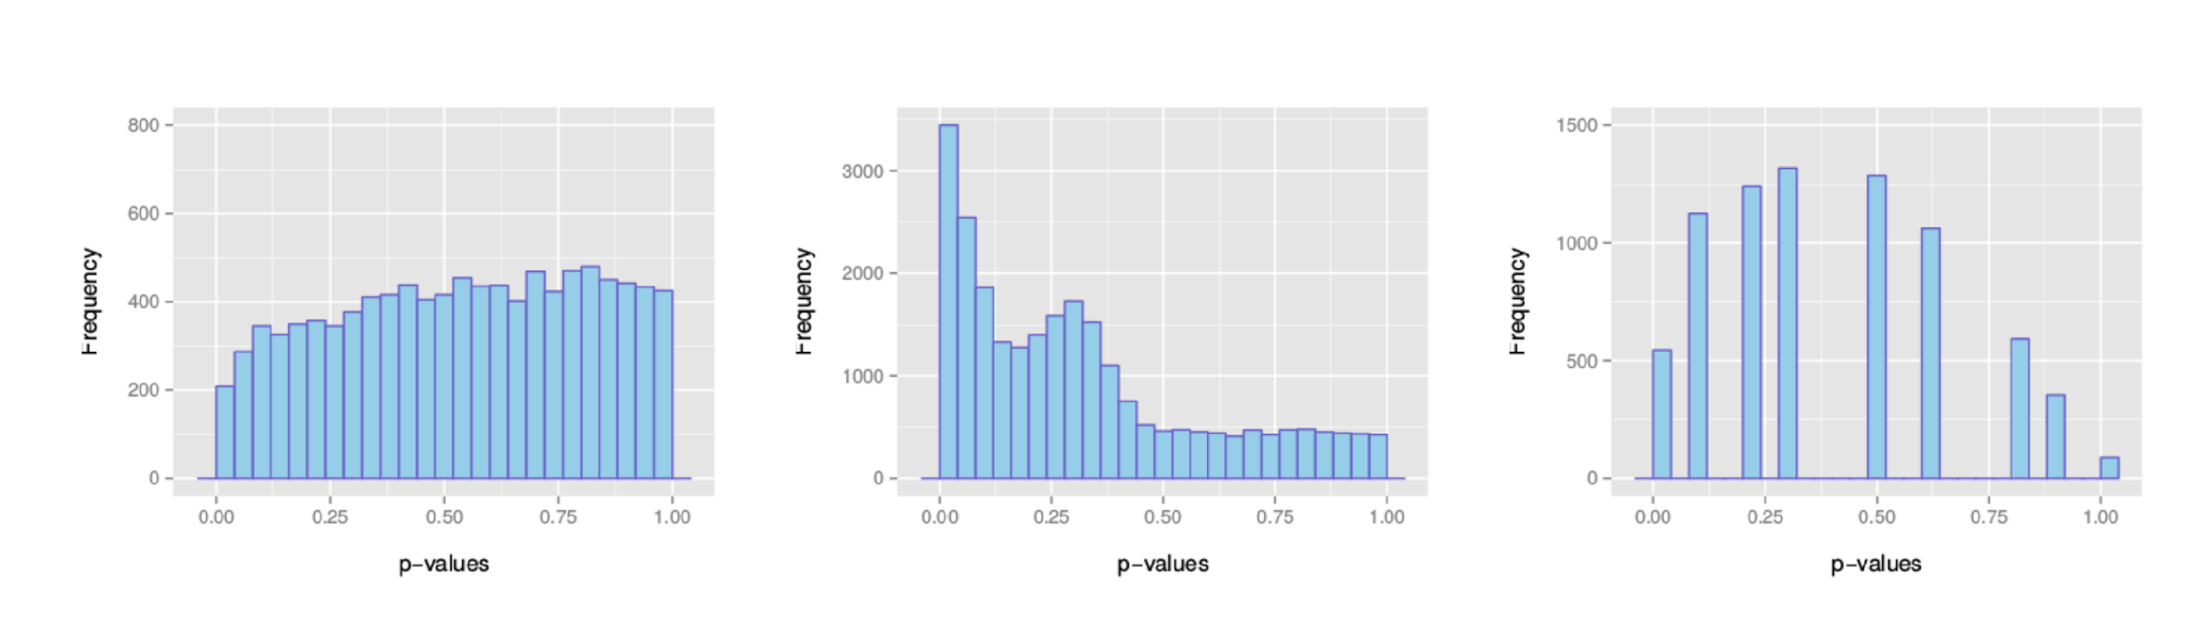
Multiplicity Correction
Examples of unexpected overall distribution
: indicates a batch effect (confounding hidden variables)
: the test statistics may be inappropriate (due to strong correlation structure for instance)
: discrete distribution of p-values : unexpected

Slide 68
Conclusions
Assumptions assumptions assumptions

